Slide 1
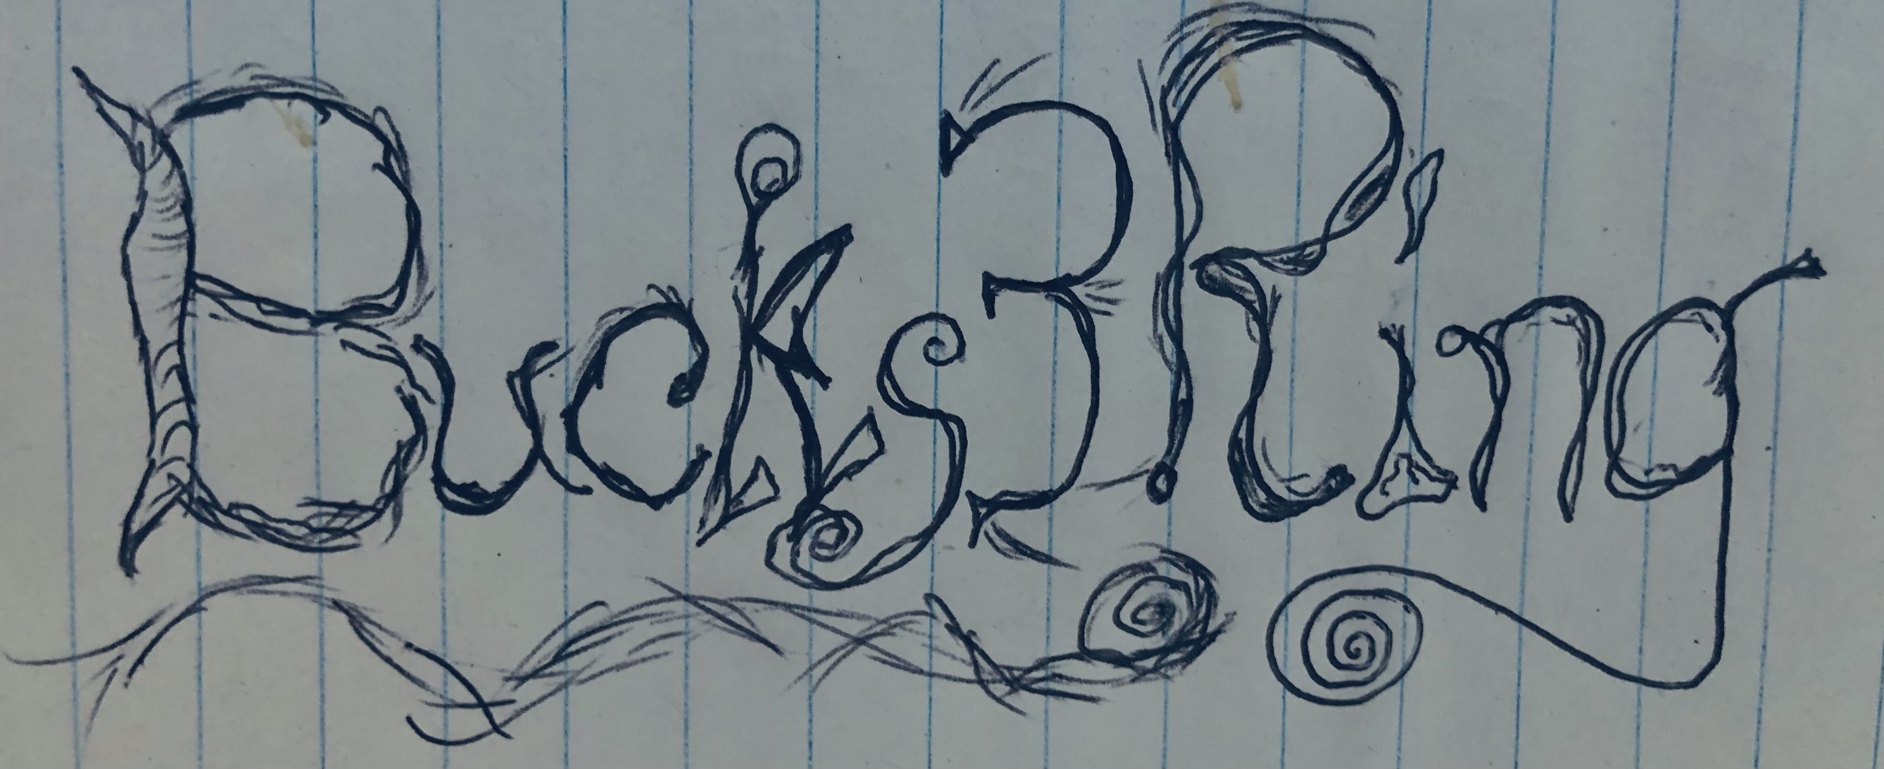
Bucks3Ring Goods & Entertainment
”Making bucks in the three-ring circus”
www.cypriankane.com
CEO/Founder:
Cyprian Kane

Slide 2
Bucks3Ring LLC
What began as a passion for audio as a child grew into the company that we now call Bucks3Ring. The idea behind the name has to do with two things. Cyprian’s grandfather's name was Buck; that was his nickname. And the way we look at this business, it resembles a three-ring circus. Thus, we want to make “Bucks in the three-ring circus,” that is, this life and business.
I began by using a simple tape recorder and using various techniques to record all kinds of fantasies. Now we are poised to bring these childhood dreams into a more solid reality.
Mission Statement—We desire to bring quality, family-oriented goods, and entertainment to the masses. By bringing a unique perspective to things, we aim to give the market a niche that it is missing.
Description of services—We write jingles for companies' advertising campaigns. We also produce artists and record fresh new talent with new music. We are an up-and-coming dynamic recording studio that aims to reach the pinnacle of our profession.

Slide 3
Biography
This company was founded by Cyprian Kane. From an early age, Cyprian was a performer on stage (in his father’s band), and also used his simple tape recorder to experiment with sound. “I used to tape Kungfu movies and then would record separate audio to match the voiceovers. I did all kinds of experiments in those days and going forward. I have never lost my sense of wonder at the world of sound.” After years of playing solo gigs and experimenting with genres, Cyprian decided to form his own company, Bucks3Ring, to bring the best music and art to the public.

Slide 4
Services
We offer a wide array of services in the realm of sound, recording, and literary realms. We write jingles for companies' advertising campaigns; we support upcoming artists through our record label; we publish and release new and original music, and we also work with game designers, filmmakers, and radio personnel to bring the best in quality entertainment and illustrious goods to the public at large. We do everything in-house; there is no subcontracting at this point. We are currently preparing to publish our first work of fiction which is complete with tie-ins to albums and other cross-references in our media universe.

Slide 5
Merchandise
At live shows, we plan to offer merchandise. This includes T-shirts, stickers, CDs, and other tools of the marketing trade. On our website, we will be offering subscriptions soon for those who want backstage access and special offers.

Slide 6
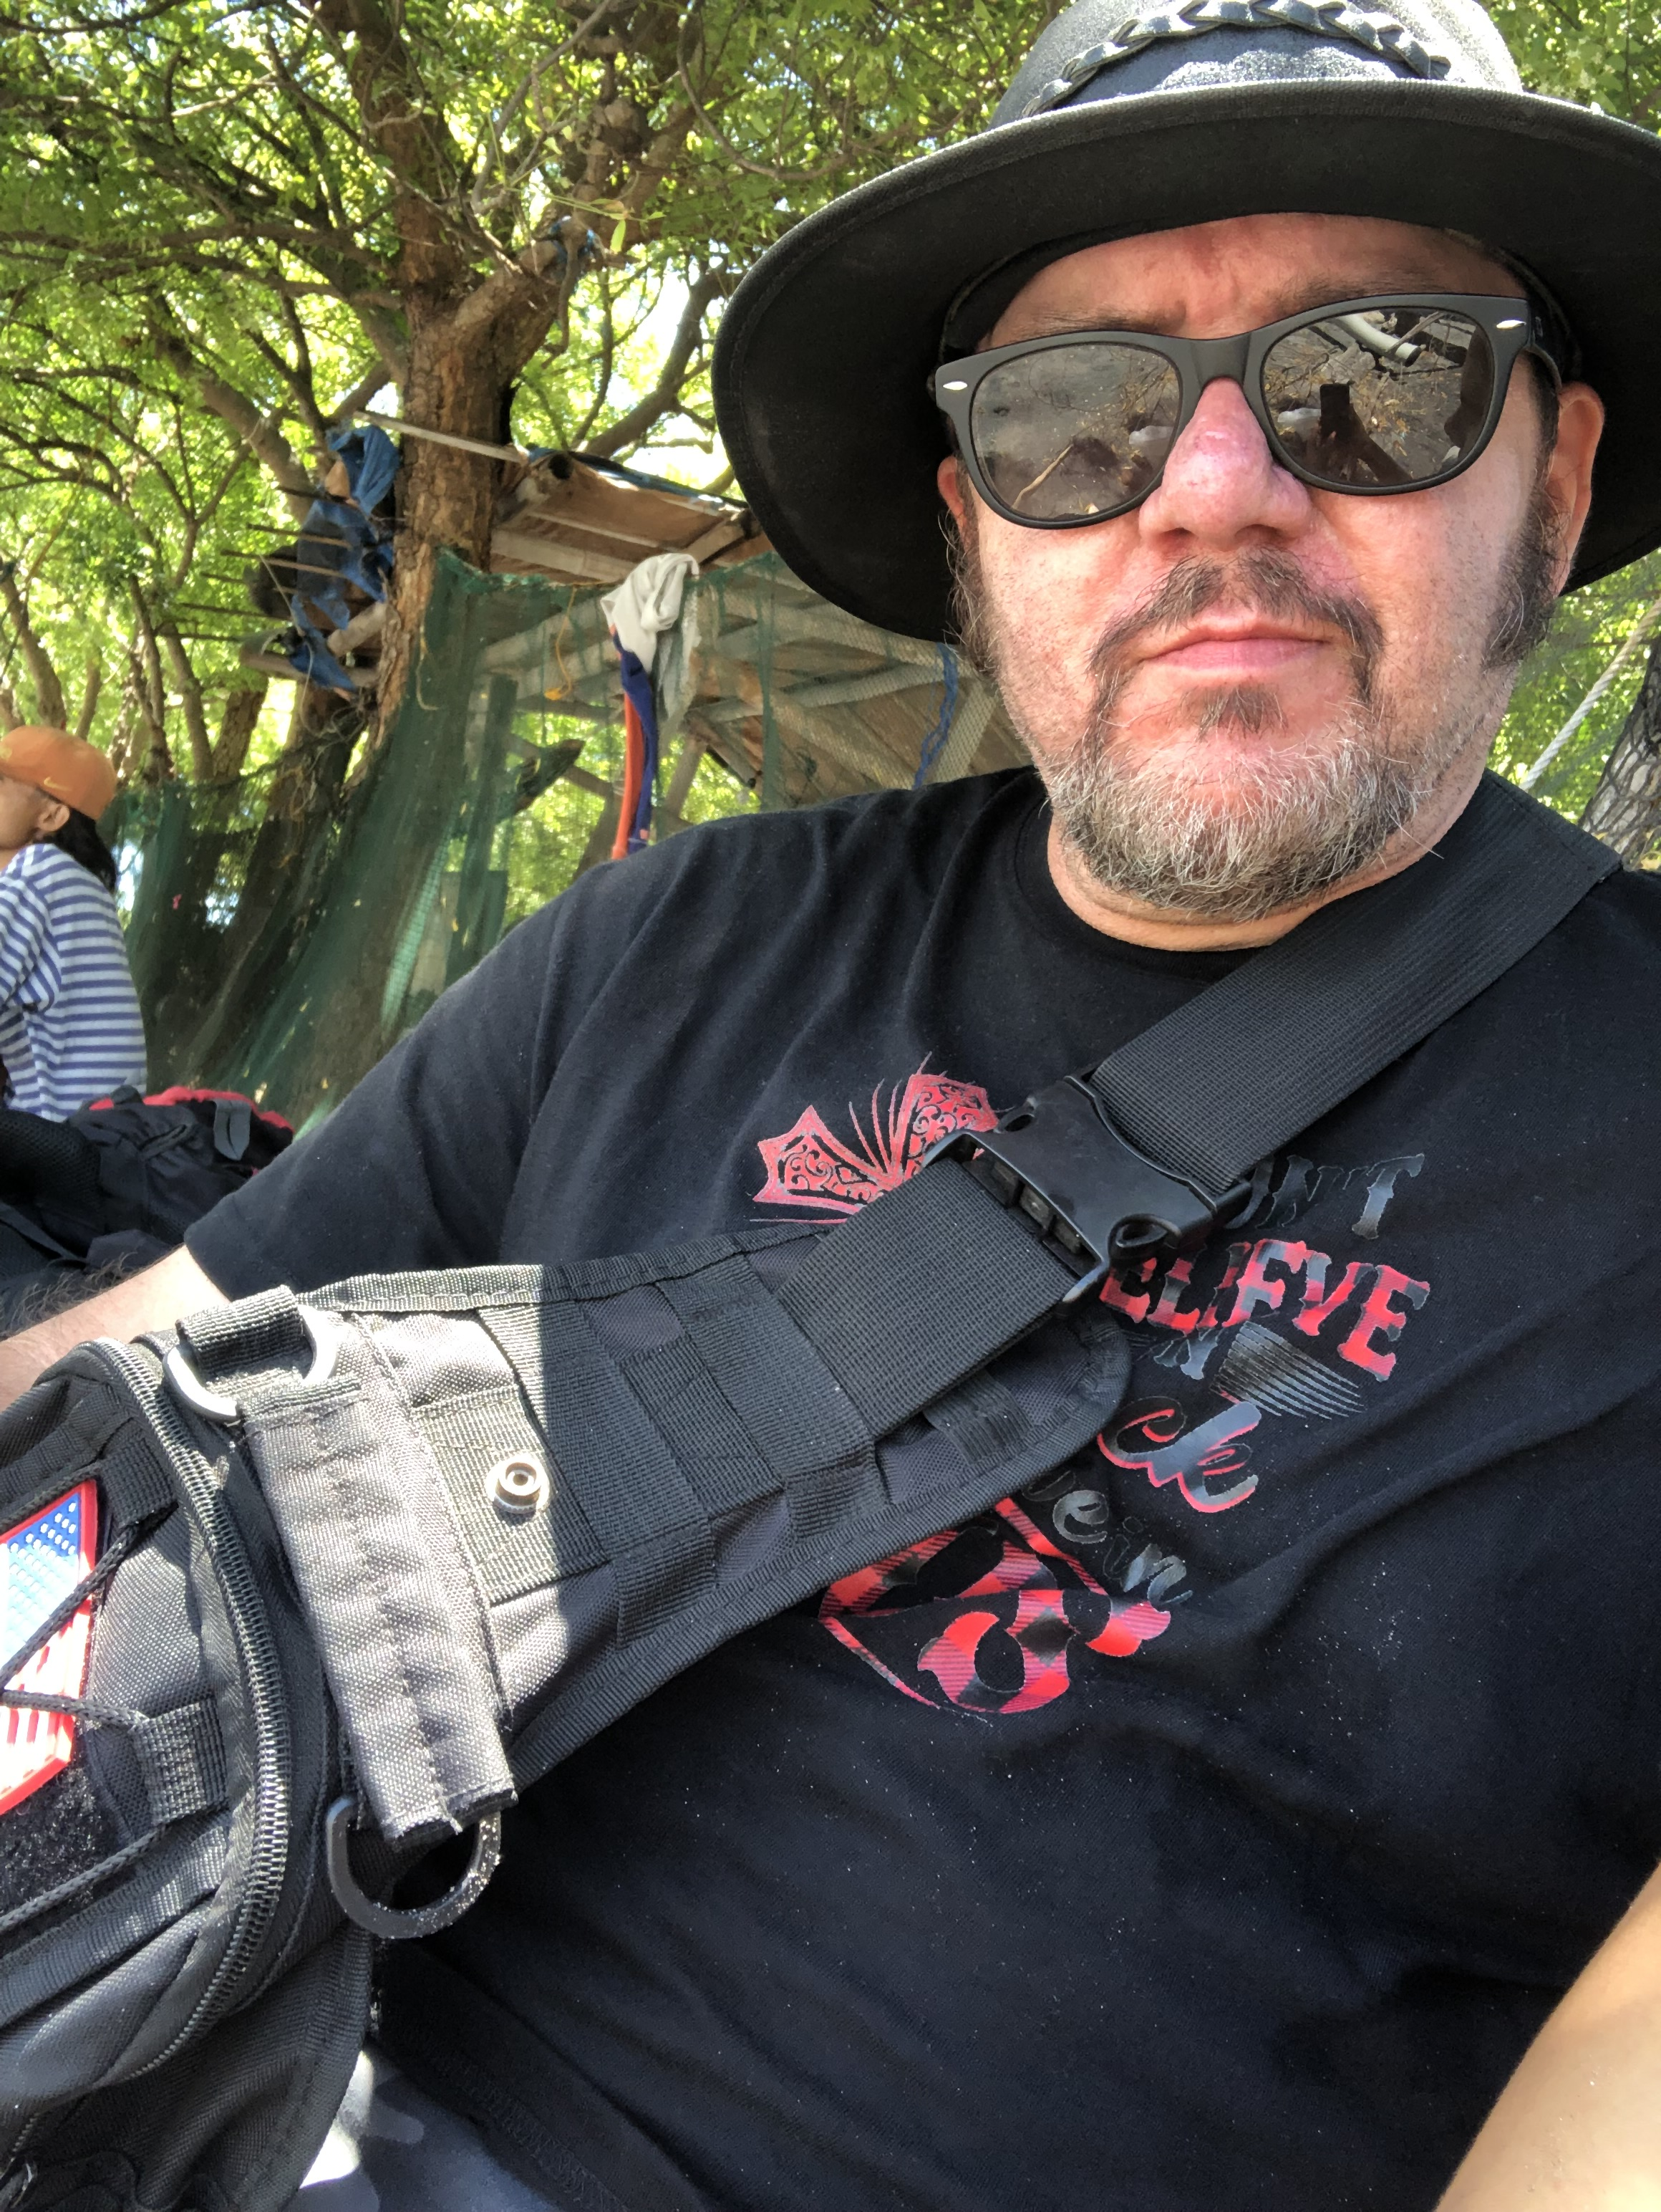
If you want to see what we currently offer..
Please go to www.cypriankane.com
We have free downloads, quality content, and more.

